Slide 1


Computer Science – Data Mining Master’s Program
Faster R-CNN: Towards Object Detection with Region Proposal Networks¹
+ Dataset and Implementation
Presenters:
Mahdi Rostami
Reza Pourbahreini
Instructor:
Dr. Ali Katanforoush
Artificial Neural Networks Course
Spring 2022

Slide 2
Outlines
Introduction
Practice
Faster R-CNN
Theory & Pipelines
Introduction
Task Definition
Applications
Concise Chronology of Recent Approaches Towards Object Detection
Region-Based Models : R-CNN , Fast R-CNN , Faster R-CNN , Mask R-CNN , Mesh R-CNN , …
Theory & Pipelines : R-CNN , Fast R-CNN , Faster R-CNN
Model Architectures
RPN ( Region Proposal Network )
Practice - Faster R-CNN
Dataset
Implementation
Results

Slide 3
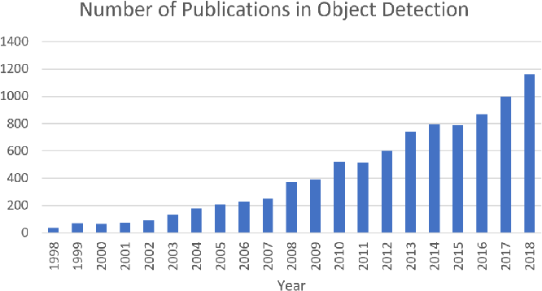
Outlines
Introduction
Practice
Faster R-CNN
Theory & Pipelines
Task Definition
Single Object
Classification
Classification + Localization
Multiple Objects
Object Detection
Instance Segmentation

Slide 4
Outlines
Introduction
Practice
Faster R-CNN
Theory & Pipelines
Applications
Manufacturing
Productivity Analysis
Visual Inspection of Equipment
Surveillance Systems
Identity Verification and Authentication
Person Detection
Motion Tracking
Healthcare
Cancer Detection
Image-based Diagnosis and Prognosis
Autonomous Driving
Pedestrian Detection
Obstacle Avoidance
Smartphones
Face Detection
Smile Detection

Slide 5
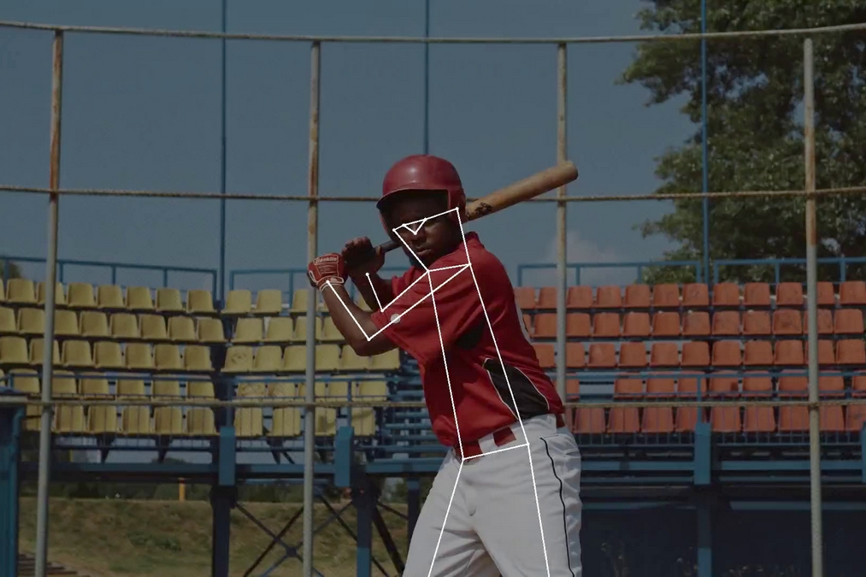
Outlines
Introduction
Practice
Faster R-CNN
Theory & Pipelines
Applications
Agriculture
Animal Monitoring
Farm Automation
Insect Detection
Transportation
Vehicle Classification
Moving Violations Detection
Driver Attentiveness Detection
Retail
Customer Tracking
Theft Detection
Sports
Player Pose Tracking
Ball Tracking
Goal-Line Technology

Slide 6
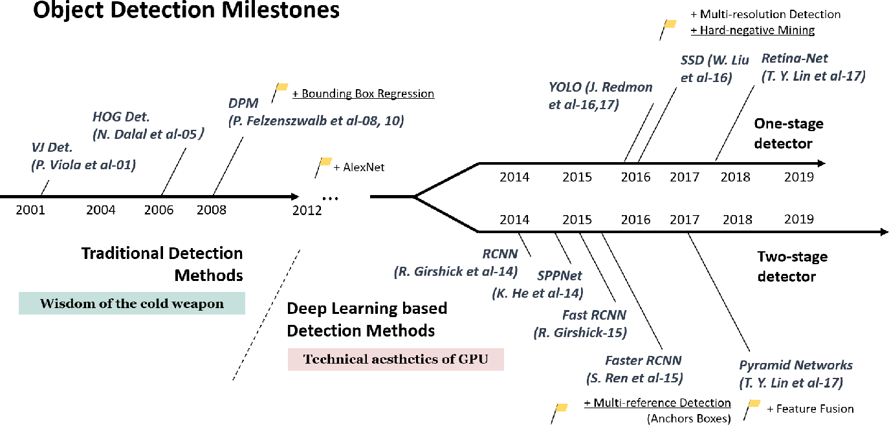
Outlines
Introduction
Practice
Faster R-CNN
Theory & Pipelines
Concise Chronology of Recent Approaches Towards Object Detection

Slide 7
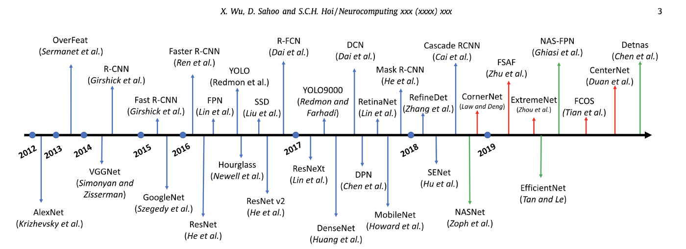
Outlines
Introduction
Practice
Faster R-CNN
Theory & Pipelines
Concise Chronology of Recent Approaches Towards Object Detection

Slide 8
Outlines
Introduction
Practice
Faster R-CNN
Theory & Pipelines
Region-Based Models
Produce a set of bounding boxes as output, where each bounding box contains an object and also the category

Slide 9
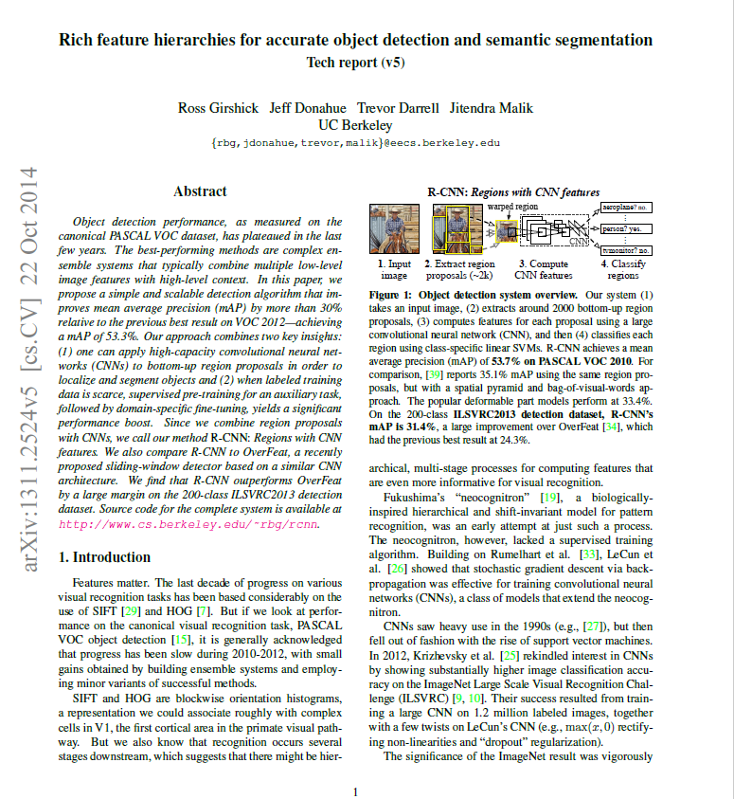
Outlines
Introduction
Practice
Faster R-CNN
Theory & Pipelines
R-CNNs
R-CNN
Fast R-CNN
Faster R-CNN
Mask R-CNN

Slide 10
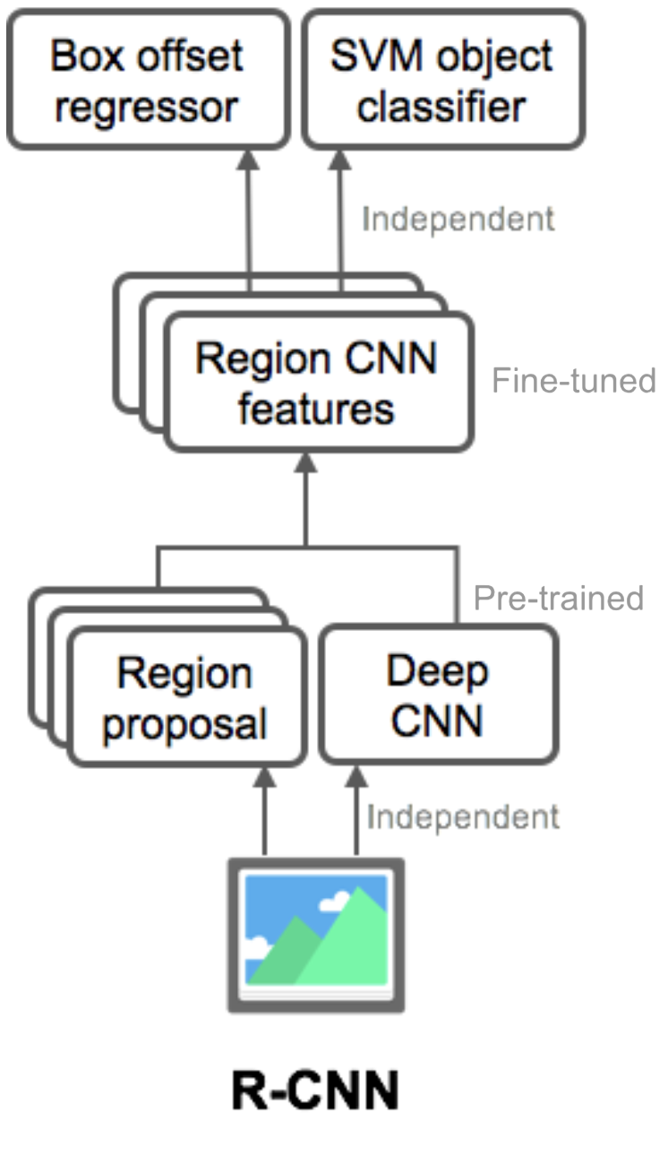
Outlines
Introduction
Practice
Faster R-CNN
Theory & Pipelines
R-CNNs :
R-CNN
Fast R-CNN
Faster R-CNN
Mask R-CNN
Scan the input image for possible objects using an algorithm called Selective Search, generating ~2000 region proposals
Run a CNN on top of each of these region proposals
Take the output of each CNN and feed it into:
an SVM to classify the region
a linear regressor to tighten the bounding box of the object, if such an object exists.
Object Detection
(2013)

Slide 11
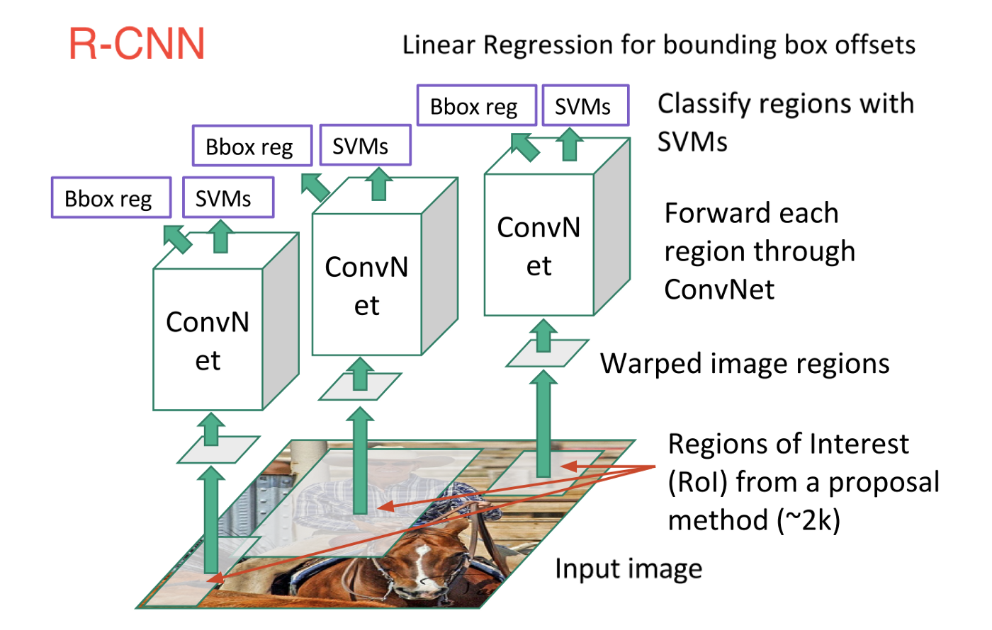
Outlines
Introduction
Practice
Faster R-CNN
Theory & Pipelines
R-CNNs :
R-CNN
Fast R-CNN
Faster R-CNN
Mask R-CNN
Object Detection
(2013)

Slide 12
Outlines
Introduction
Practice
Faster R-CNN
Theory & Pipelines
R-CNNs :
R-CNN
Fast R-CNN
Faster R-CNN
Mask R-CNN
Problems with R-CNN
Huge amount of time to train the network
(you would have to classify 2000 region proposals per image)
Cannot be implemented real time
(47 seconds for each test image)
The selective search algorithm is a fixed algorithm
(generation of bad candidate region proposals)
Object Detection
(2013)

Slide 13
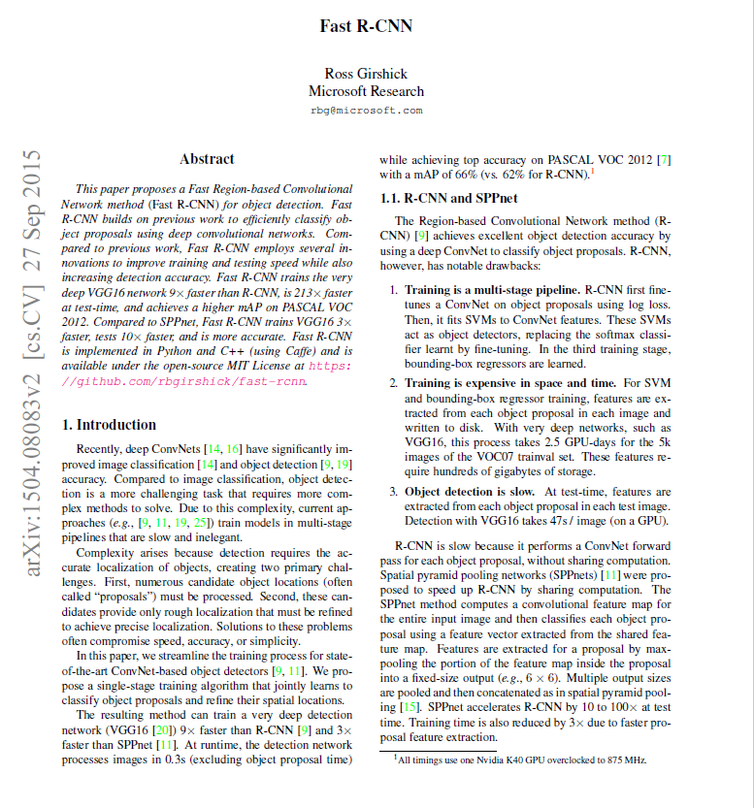
Outlines
Introduction
Practice
Faster R-CNN
Theory & Pipelines
R-CNNs :
R-CNN
Fast R-CNN
Faster R-CNN
Mask R-CNN

Slide 14
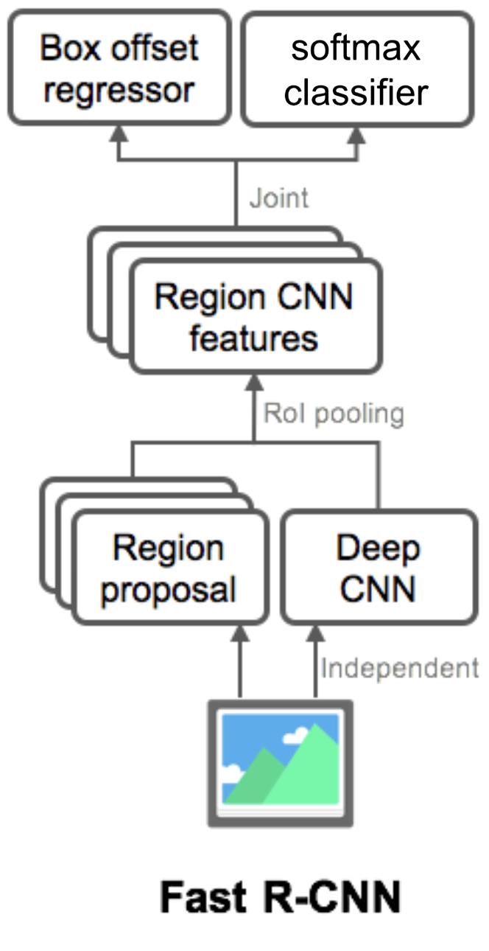
Outlines
Introduction
Practice
Faster R-CNN
Theory & Pipelines
R-CNNs :
R-CNN
Fast R-CNN
Faster R-CNN
Mask R-CNN
Feature extraction over the image before proposing regions
Replacing the SVM with a SoftMax layer
Object Detection
(2015)

Slide 15
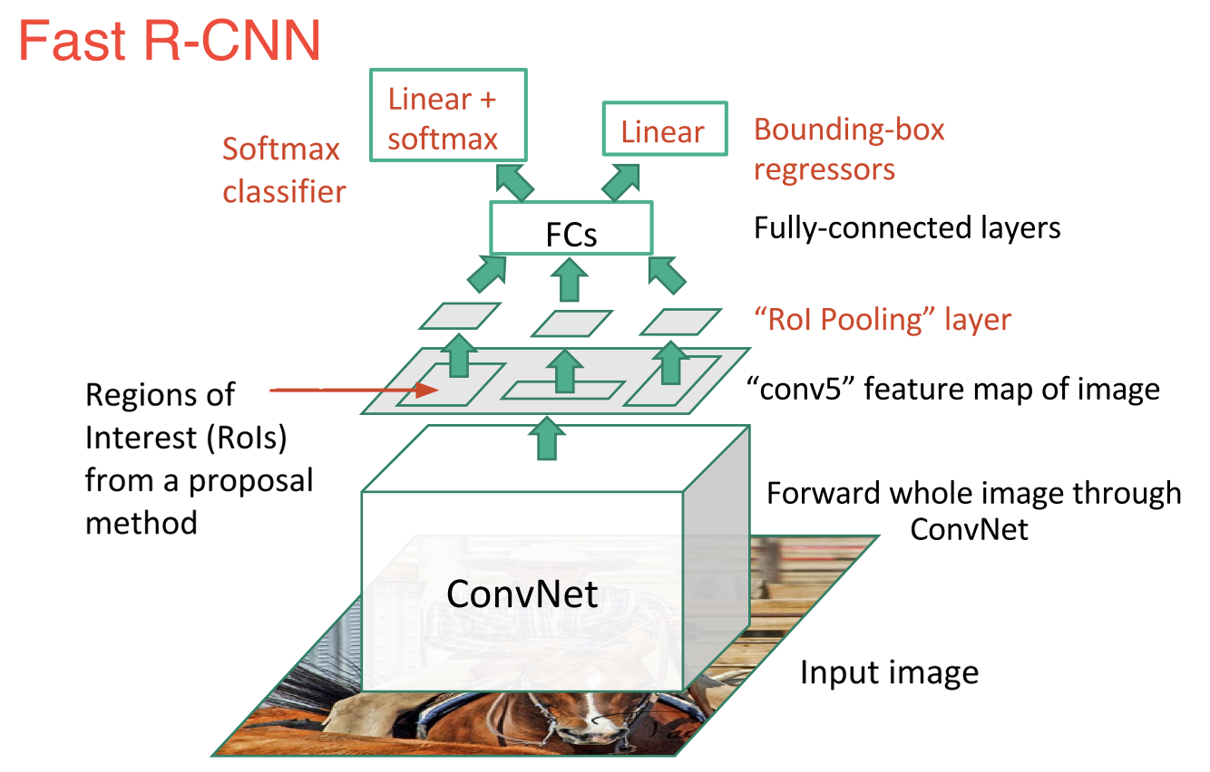
Outlines
Introduction
Practice
Faster R-CNN
Theory & Pipelines
R-CNNs :
R-CNN
Fast R-CNN
Faster R-CNN
Mask R-CNN
Object Detection
(2015)

Slide 16
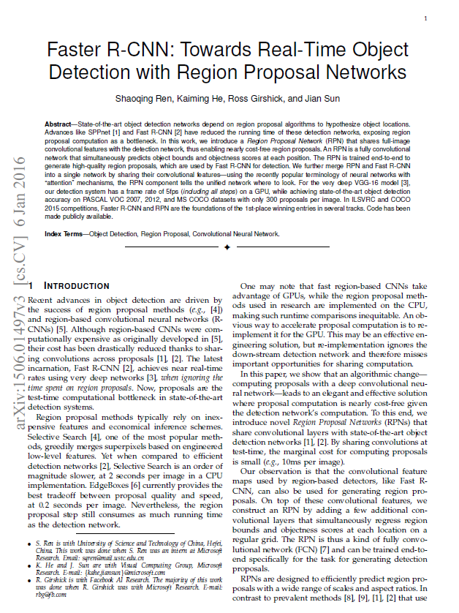
Outlines
Introduction
Practice
Faster R-CNN
Theory & Pipelines
R-CNNs :
R-CNN
Fast R-CNN
Faster R-CNN
Mask R-CNN

Slide 17
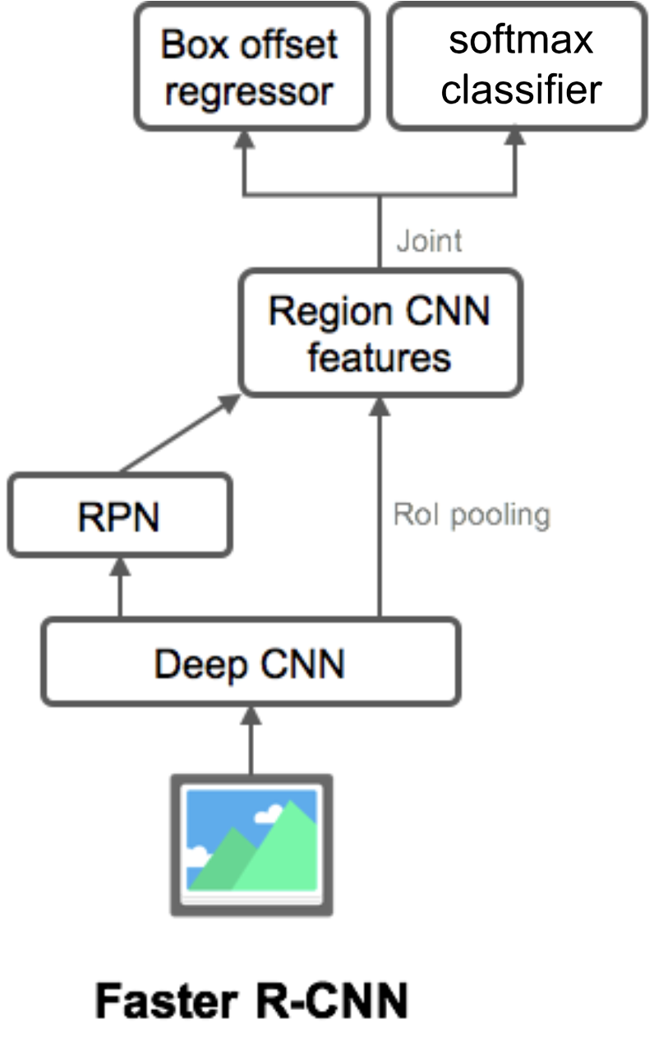
Outlines
Introduction
Practice
Faster R-CNN
Theory & Pipelines
R-CNNs :
R-CNN
Fast R-CNN
Faster R-CNN
Mask R-CNN
One of the drawbacks of R-CNN and Fast R-CNN:
Slow selective search algorithm for region proposal
Faster R-CNN:
introducing something called Region Proposal Network (RPN)
Faster R-CNN = RPN + Fast R-CNN
Object Detection
(2015)

Slide 18
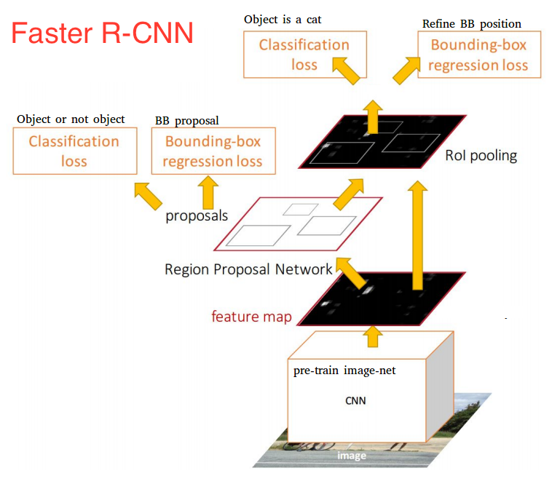
Outlines
Introduction
Practice
Faster R-CNN
Theory & Pipelines
R-CNNs :
R-CNN
Fast R-CNN
Faster R-CNN
Mask R-CNN
Object Detection
(2015)

Slide 19
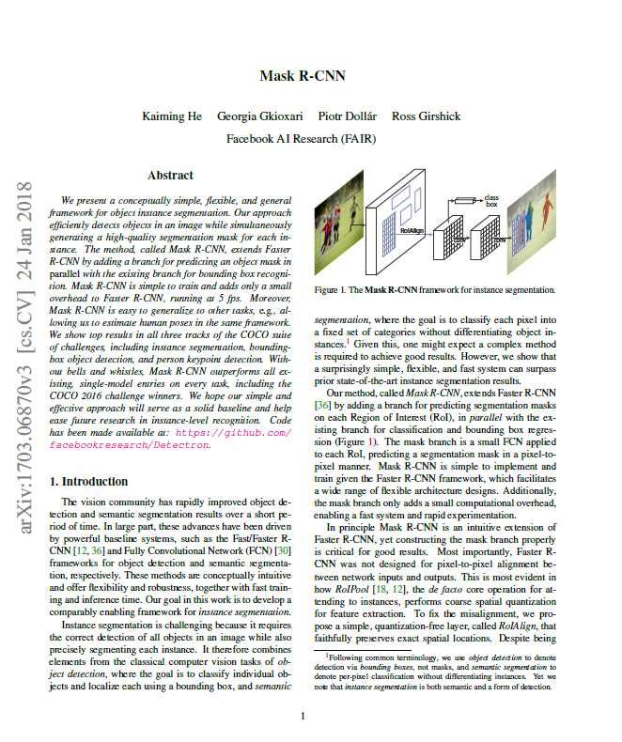
Outlines
Introduction
Practice
Faster R-CNN
Theory & Pipelines
R-CNNs :
R-CNN
Fast R-CNN
Faster R-CNN
Mask R-CNN

Slide 20
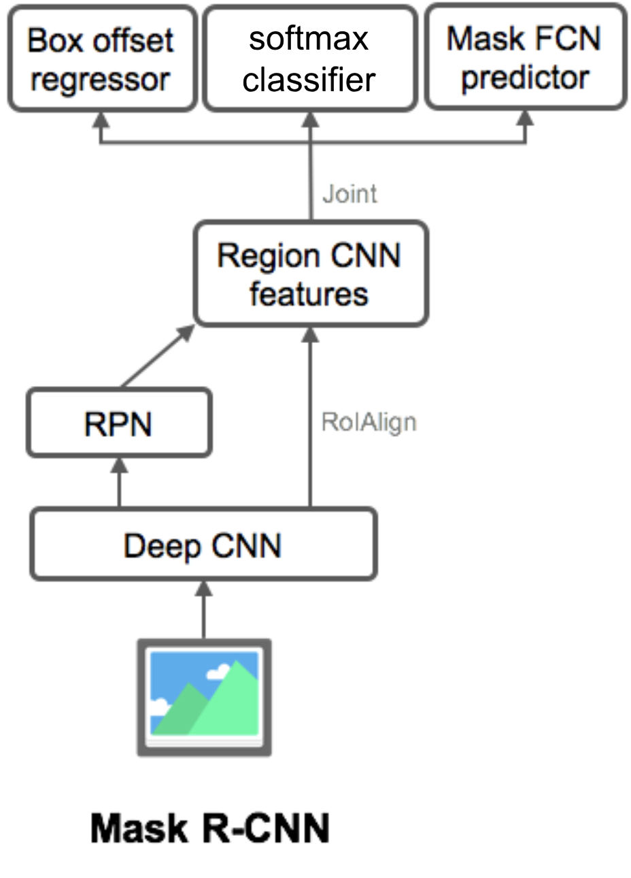
Outlines
Introduction
Practice
Faster R-CNN
Theory & Pipelines
R-CNNs :
R-CNN
Fast R-CNN
Faster R-CNN
Mask R-CNN
Object Detection
(2013)
Object Detection
(2015)
Object Detection
(2015)
Instance Segmentation
(2017)

Slide 21
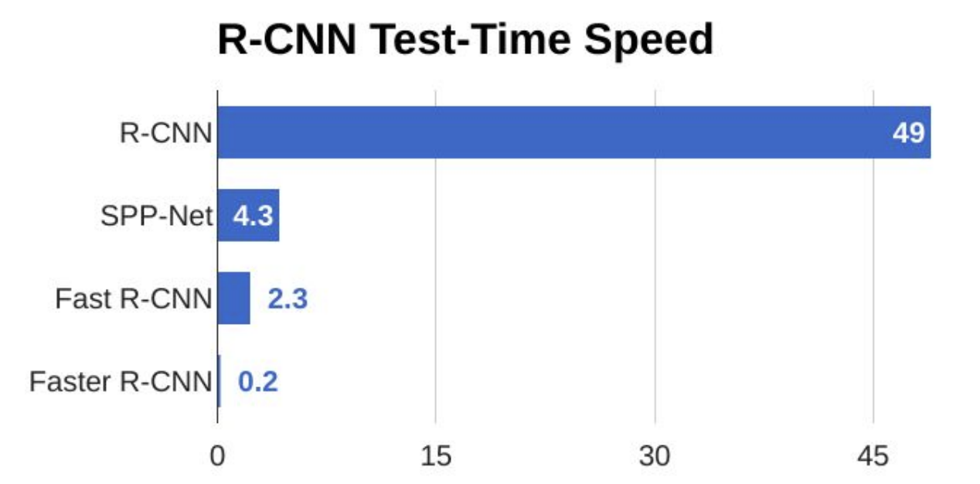
Outlines
Introduction
Practice
Faster R-CNN
Theory & Pipelines
R-CNNs :
R-CNN
Fast R-CNN
Faster R-CNN
Mask R-CNN
 | R-CNN | Fast R-CNN | Faster R-CNN
Region Proposals Method | Selective search | Selective search | Region proposal network
Prediction Timing | 40-50 sec | 2 seconds | 0.2 seconds
computation | High computation time | High computation time | Low computation time
The mAP on Pascal VOC 2007 Test Dataset(%) | 58.5 | 66.9 (when trained with VOC 2007 only) | 69.9(when trained with VOC 2007 only)
 |  | 70.0 (when trained with VOC 2007 and 2012 both)
The mAP on Pascal VOC 2012 Test Dataset (%) | 53.3 | 65.7 (when trained with VOC 2012 only) | 67.0(when trained with VOC 2012 only)
 |  | 68.4 (when trained with VOC 2007 and 2012 both) | 70.4 (when trained with VOC 2007 and 2012 both)
 |  |  | 75.9(when trained with VOC 2007 and 2012 and COCO)

Slide 22
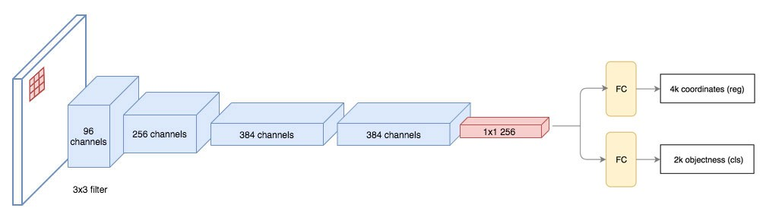
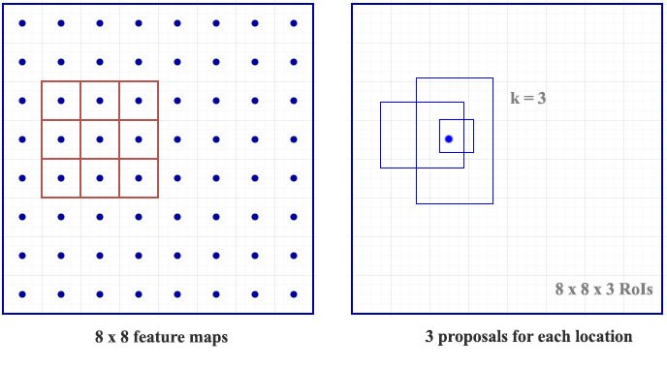
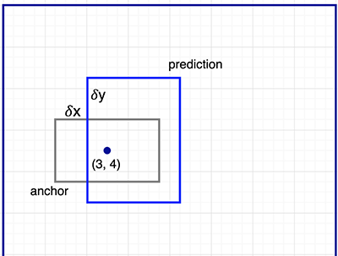
Outlines
Introduction
Practice
Faster R-CNN
Theory & Pipelines
RPN ( Region Proposal Network )

Slide 23
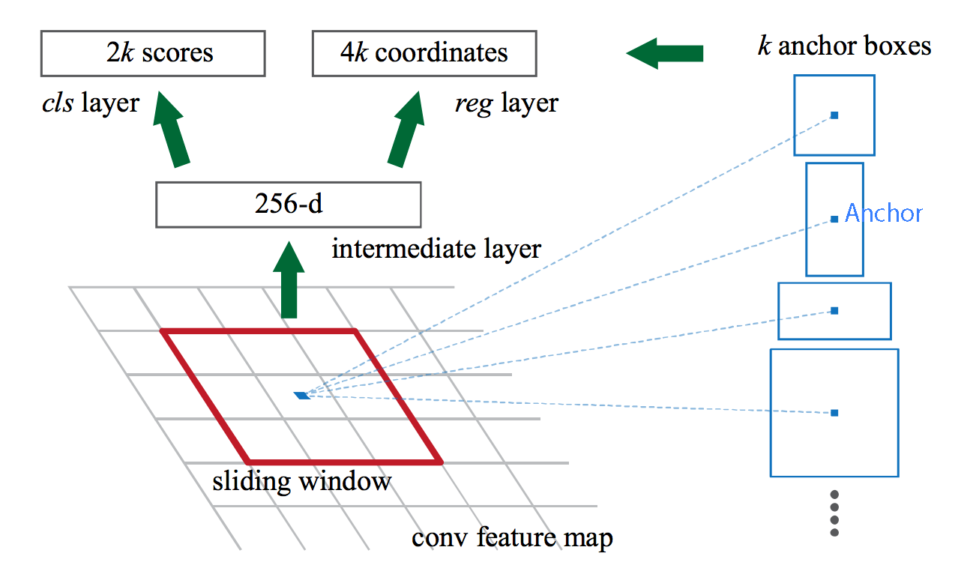
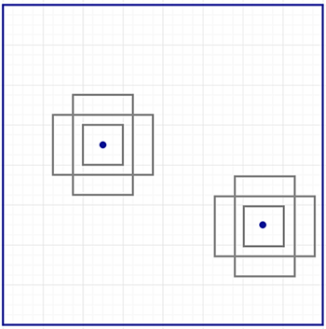
Outlines
Introduction
Practice
Faster R-CNN
Theory & Pipelines
RPN ( Region Proposal Network )
Number of guesses : k
Objectiveness score
Bounding-box coordinates
Anchors (Default boundary boxes)

Slide 24
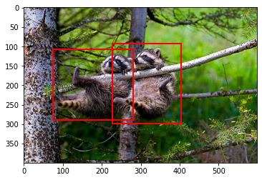
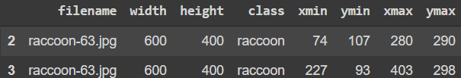
Outlines
Introduction
Practice
Faster R-CNN
Theory & Pipelines
Code Summary
Programming language : Python
IDE : Google Colab / Jupyter Notebook Format (ipynb) [Click Here]
ML Framework : Pytorch
Runtime Type : GPU
Dataset : Raccooon_dataset
Size of Dataset : 200 ( 160 : Train Phase / 40 : Validation Phase )
Based on Google Images and Pixabay
Self-Annotated
Resolution : Width : 600 / Height : 400
Bounding Box info : (xmin , ymin , xmax , ymax)

Slide 25
Outlines
Introduction
Practice
Faster R-CNN
Theory & Pipelines
Prerequisites
Importing Frameworks
Changing Runtime Type
Dataset Configuration (torch.utils.data.Dataset)
Custom Dataset
Data Loader
Importing Dataset
Models
resnet50 backbone
mobilenet_v2 backbone
Optimizers
Optimizer1: SGD
Optimizer2: SGD + Momentum
Optimizer3: SGD + Momentum + Weight Decay
Train Phase
resnet50 Training Optimizer 1 Optimizer 2 Optimizer 3
mobilenet_v2 Training Optimizer 3
Evaluation Phase
Resnet50 Model + Optimizer 3
Implementation Workflow

Slide 26
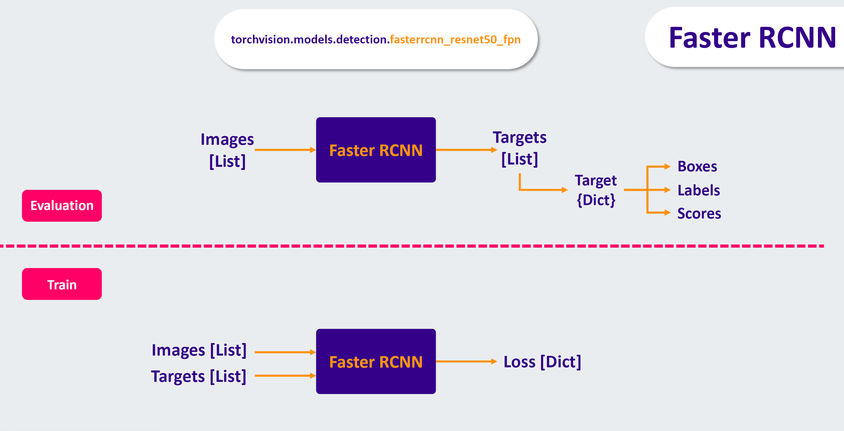
Outlines
Introduction
Practice
Faster R-CNN
Theory & Pipelines

Slide 27
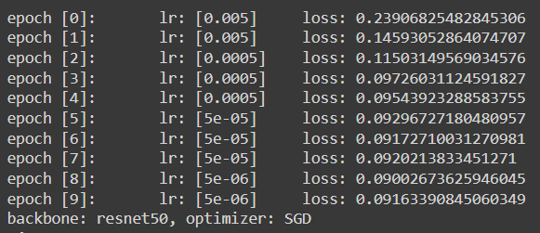
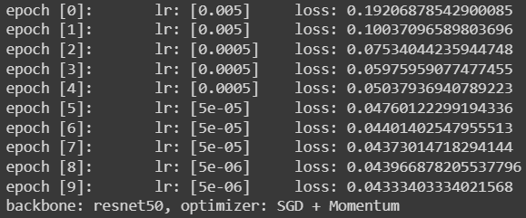
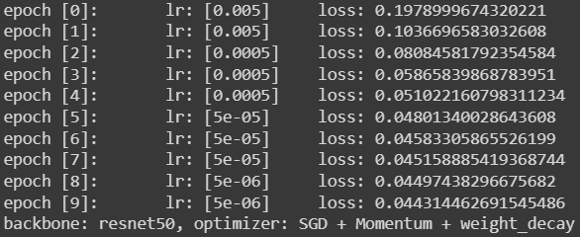
Outlines
Introduction
Practice
Faster R-CNN
Theory & Pipelines
Training Error Profiles ( resnet50 Backbone )

Slide 28
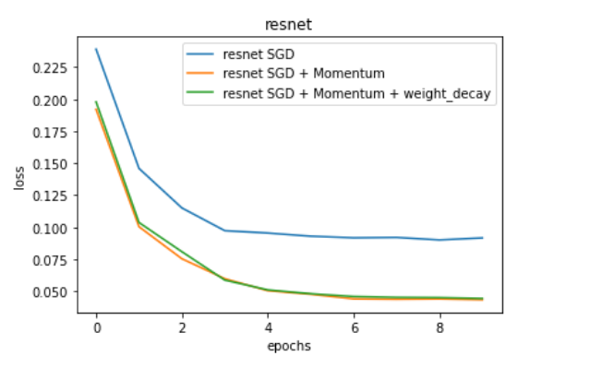
Outlines
Introduction
Practice
Faster R-CNN
Theory & Pipelines
Training Error Profiles ( resnet50 Backbone )

Slide 29
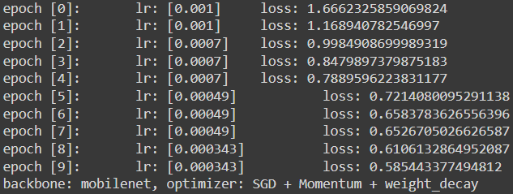
Outlines
Introduction
Practice
Faster R-CNN
Theory & Pipelines
Training Error Profiles ( mobilenet_v2 Backbone + Optimizer 3 {SGD + Momentum + Weight Decay})

Slide 30
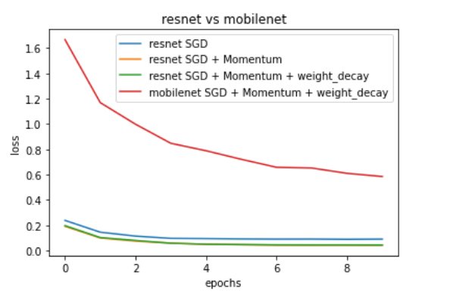
Outlines
Introduction
Practice
Faster R-CNN
Theory & Pipelines
Training Error Profiles ( mobilenet_v2 Backbone + Optimizer 3 {SGD + Momentum + Weight Decay})

Slide 31
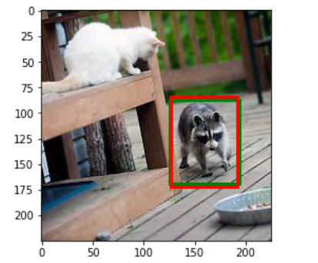
Outlines
Introduction
Practice
Faster R-CNN
Theory & Pipelines
Evaluation Results (resnet Backbone + Optimizer 3 {SGD + Momentum + Weight Decay})
In evaluation, the model gives us scores with boxes (boxes with score > 0.7)
Red : Model suggestions / Green : Targets

Slide 32
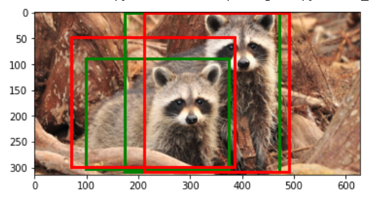
Outlines
Introduction
Practice
Faster R-CNN
Theory & Pipelines
Evaluation Results (resnet Backbone + Optimizer 3 {SGD + Momentum + weight_decay)
In evaluation, the model gives us scores with boxes (boxes with score > 0.7)
Red : Model suggestions / Green : Targets

Slide 33
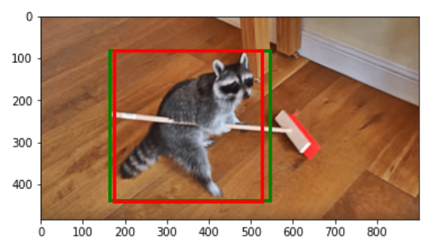
Outlines
Introduction
Practice
Faster R-CNN
Theory & Pipelines
Evaluation Results (resnet Backbone + Optimizer 3 {SGD + Momentum + weight_decay)
In evaluation, the model gives us scores with boxes (boxes with score > 0.7)
Red : Model suggestions / Green : Targets

Slide 34
Outlines
Introduction
Practice
Faster R-CNN
Theory & Pipelines
Evaluation Results (resnet Backbone + Optimizer 3 {SGD + Momentum + weight_decay)
In evaluation, the model gives us scores with boxes (boxes with score > 0.7)
Red : Model suggestions / Green : Targets

Slide 35
Outlines
Introduction
Practice
Faster R-CNN
Theory & Pipelines
References
Main Paper:
Faster R-CNN: Towards Object Detection with Region Proposal Networks - Shaoqing Ren, Kaiming He, Ross Girshick, and Jian Sun- NIPS’ 15 - Published: Dec 2015
Dataset:
Raccooon_dataset
Other References:
Object detection: speed and accuracy comparison (Faster R-CNN, R-FCN, SSD, FPN, RetinaNet and YOLOv3)
R-CNN vs Fast R-CNN vs Faster R-CNN – A Comparative Guide
R-CNN for object detection : A technical paper summary
Fast R-CNN for object detection : A technical paper summary
Faster R-CNN for object detection : A technical paper summary
Distilled Notes for Stanford CS231n: Convolutional Neural Networks for Visual Recognition
Deep Learning for Object Detection: A Comprehensive Review
CS231n Winter 2016: Lecture 8: Localization and Detection ( Stanford Winter Quarter 2016 Class)
MaskRCNN with MobileNet backbone

